Slide 1
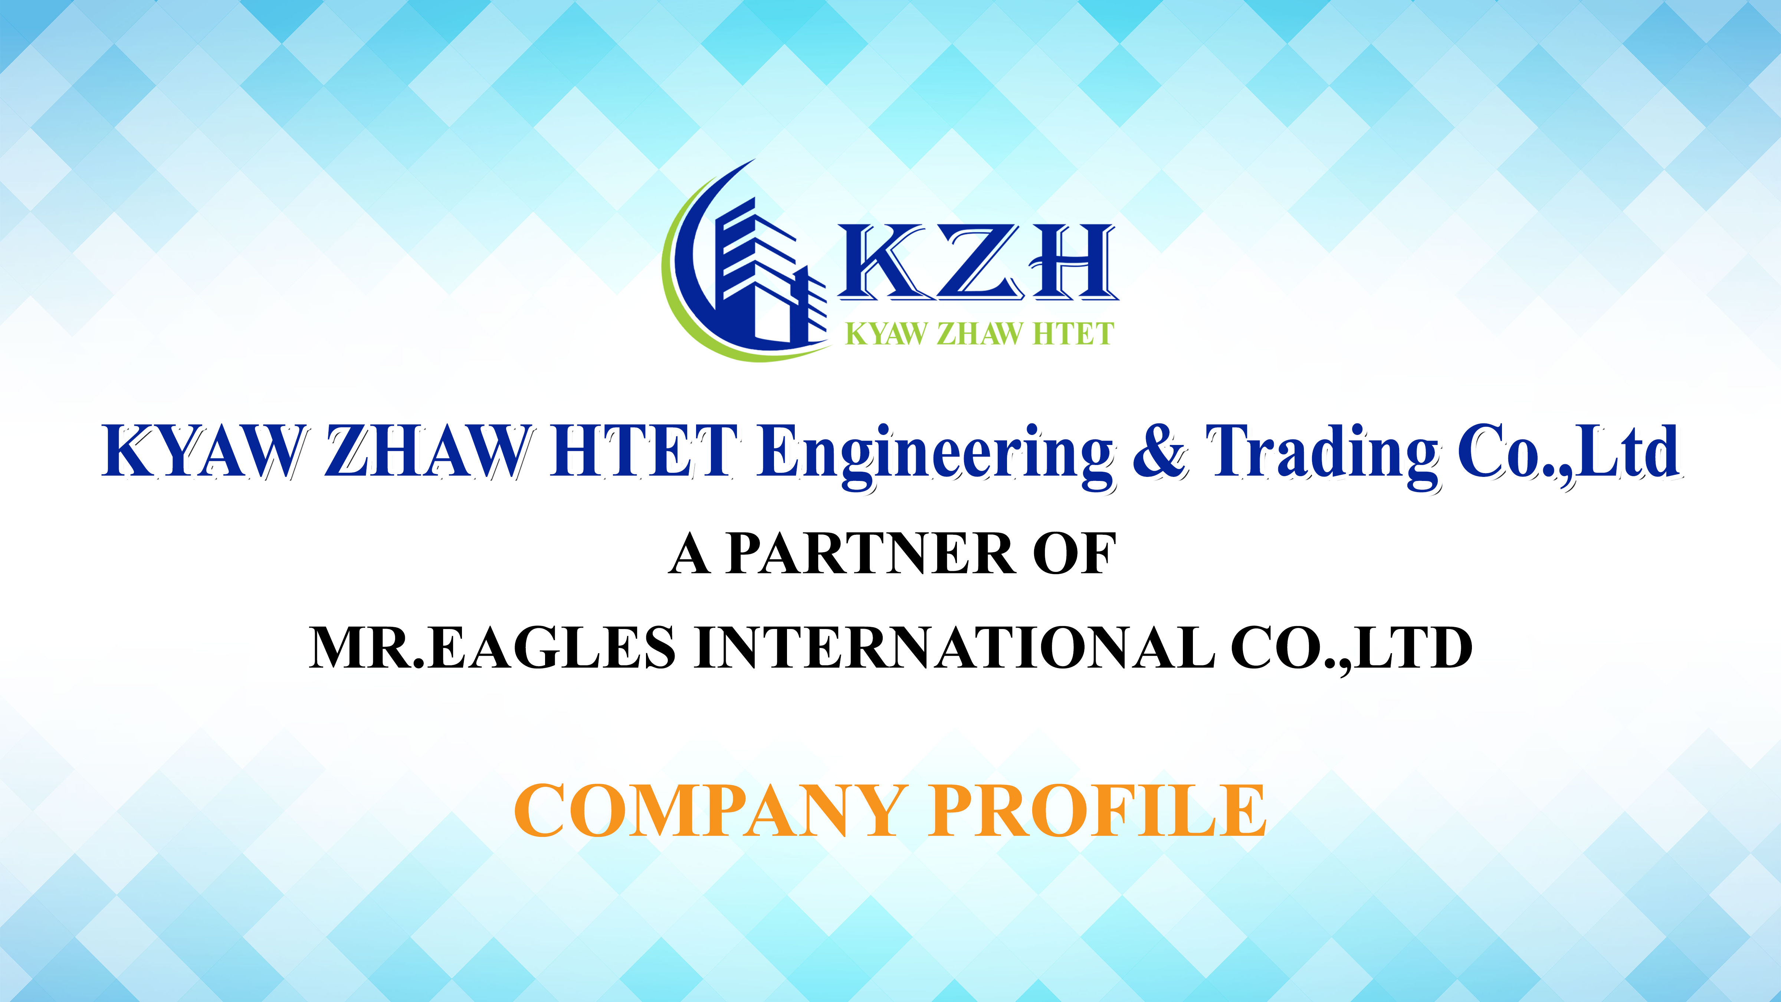

Slide 2
OUR BOARD OF DIRECTORS
U Hla Kyaw Htun is the founder and Managing Director of K.Z.H Engineering & Trading Co., Ltd, which has businesses in Generators, power & energy and also construction. U Hla Kyaw Htun established the K.Z.H Engineering & Trading Co., Ltd in 2020.
Prior to K.Z.H, he was Business Development Manager of Aung Gyi Group of Companies, with responsible included Tender, sale and supply of Heavy Machinery, Generators, electrical and mechanical equipment to the Myanmar Government. Before that, U Hla Kyaw Htun has worked in IGE Group of Companies as Senior Sales Engineer, with responsibilities includes supply chain, tendering & private sales of electrical and mechanical equipment from 2013 to 2018.
U Hla Kyaw Htun holds a Bachelor of Engineering (Mechanical) from Technological University, Yamethin in 2012. U Hla Kyaw Htun is fluent in English.
U Hla Kyaw Htun
Managing Director

Slide 3
OUR BOARD OF DIRECTORS
U TunWin Soeis appointed as a Board of Director. He has over 10 years of Sales & Marketing and also Management experience.
Prior to joining K.Z.H, U TunWin Soeserved as a Sales Manager of procurement unit for electrical materials at Asia Power Quality Co.,Ltdfrom 2018 to 2020. In that role, he sales & marketing team in awarded government projects for electrical transmission and distribution in high, medium and low voltage levels. He formerly served as Sales Engineer of Smart Electrical Trading Co.,Ltdfrom 2010 to 2018, which is in trading business in power and energy sector.
U TunWin Soeholds Diploma in Mechatronic from Technological University, Magwayin 2009 .
U Tun Win Soe
Board of Director

Slide 4
REGISRTATION
Company Registration
Ex-Import Registration

Slide 5
VISION
To become a leading corporation in different business fields for giving value to the society domestically and internationally.

Slide 6
OUR MOTTO
Sales Motto
Quality More Than Price
Services Motto
QSQ- Quick, Smart & Quality Services

Slide 7
MISSION
Develops both quality and quantity of products as well as service. Committed to ensure our customers and business partners are provided with generous hospitality, goods and services. Determined to devote heart and soul for satisfying our customers.

Slide 8
MISSION
KYAW ZHAW HTET Engineering & Trading Company Limited is one of the Engineering & Trading Company which was established in 2020.
KYAW ZHAW HTET Engineering & Trading Company Limited ) was established in 2020 as Engineering & Service Works, Generator Sales, Renewable Energy and Other Mechanical & Electrical Products Sales & Services
Shwe Pon San Sheet Metals Work Factory (A Partener of KYAW ZHAW HTET Engineering & Trading Company Limited ) was established in 2012 as Production of Sheet Metals, Steel Structure and Forming Process (Molds, Dies, etc,...)
KYAW ZHAW HTET Engineering & Trading Company Limited is comprised of three major business units, namely
Sheet Metals Work ( Production, Installation & Services)
Renewable Energy (Supply Solar, Battery, Inverter, etc)
Automatic Voltage Stabilizer Sales & Services
POWERE@GLE Brand Generators & Machinery Sales
KYAW ZHAW HTET Engineering & Trading Company Limited has strongly setup of Private Project, Tender supply for Government and Private stakeholders.

Slide 9
OUR BUINESS
Construction Sectors
Housing & Development
Road & Bridge Construction
Renovation of Housing, Road & Bridge
Production
•DistributionPanel
•CableTray,Ladder,Trunking&Accessories
•FormingProcess,Molds,Dies,…etc
Power & Energy Sectors
Supply Project on Power Sectors
Supply Project on Energy Sectors
Air Conditioner Sales & Services
Elevator, Escalator Sales & Services
Generators , Machinery Sales & Services
Renewable Energy (Supply Solar, Battery, Inverter, etc)

Slide 10
COMPANY SERVICES
Sheet Metals Works & Production

Slide 11
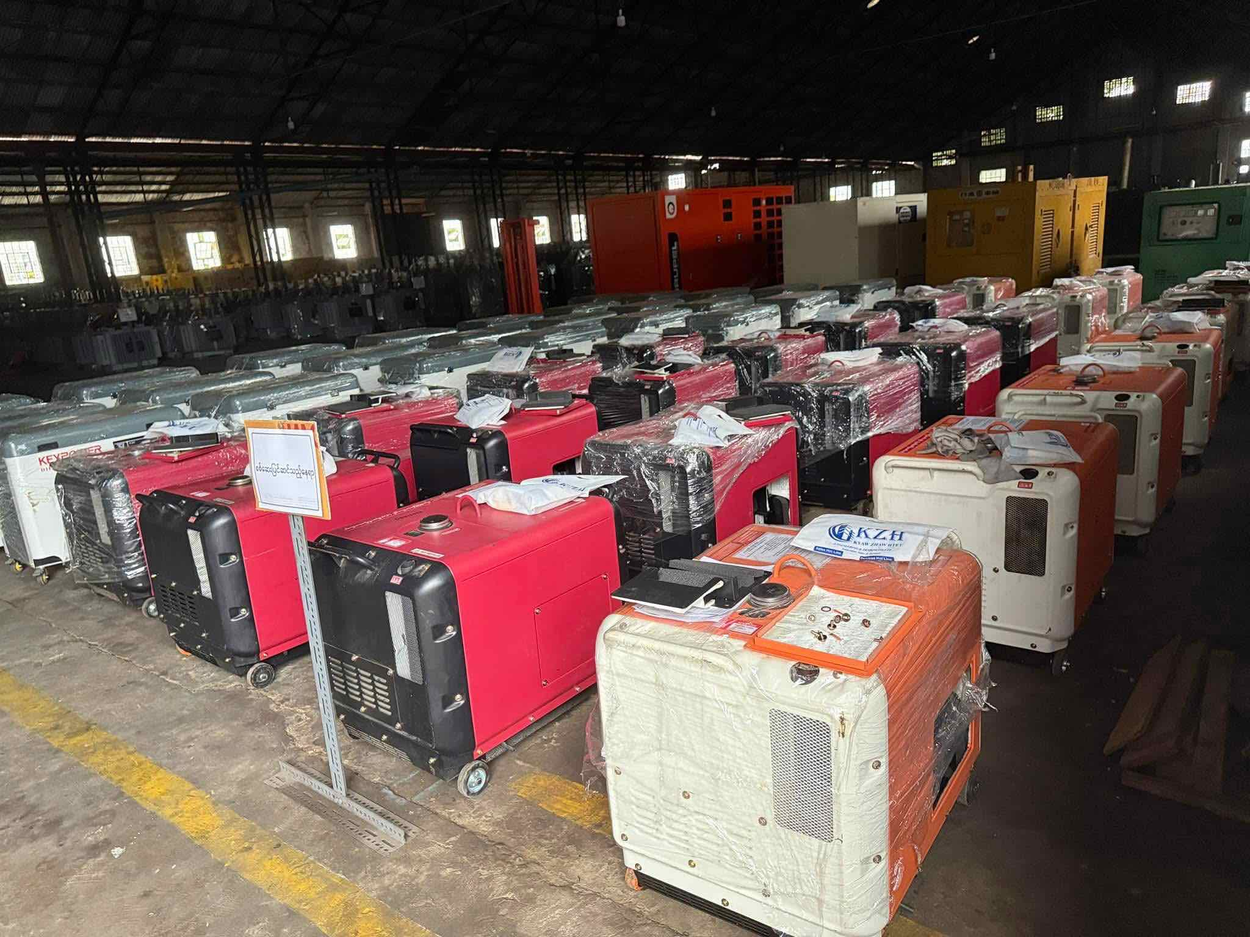
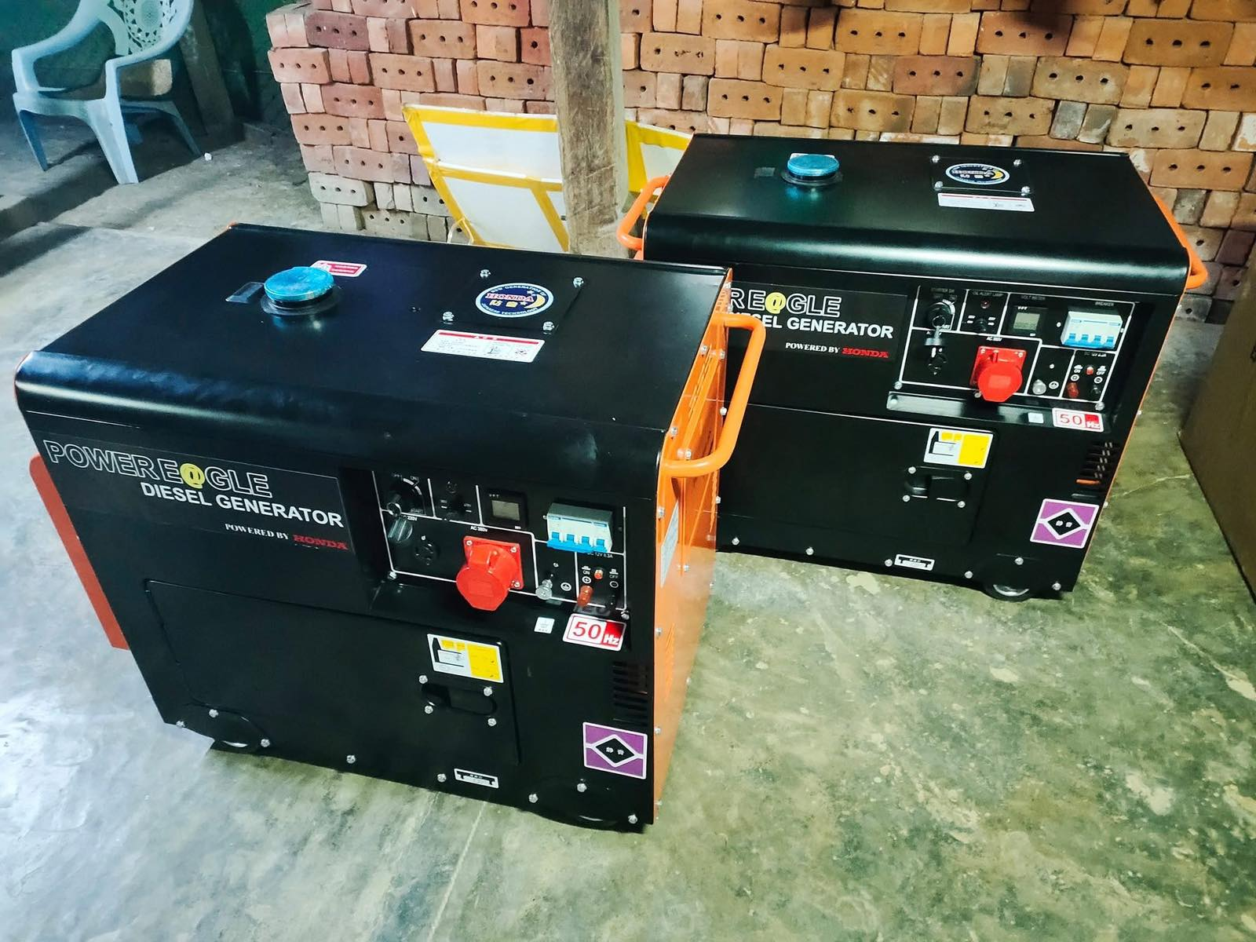
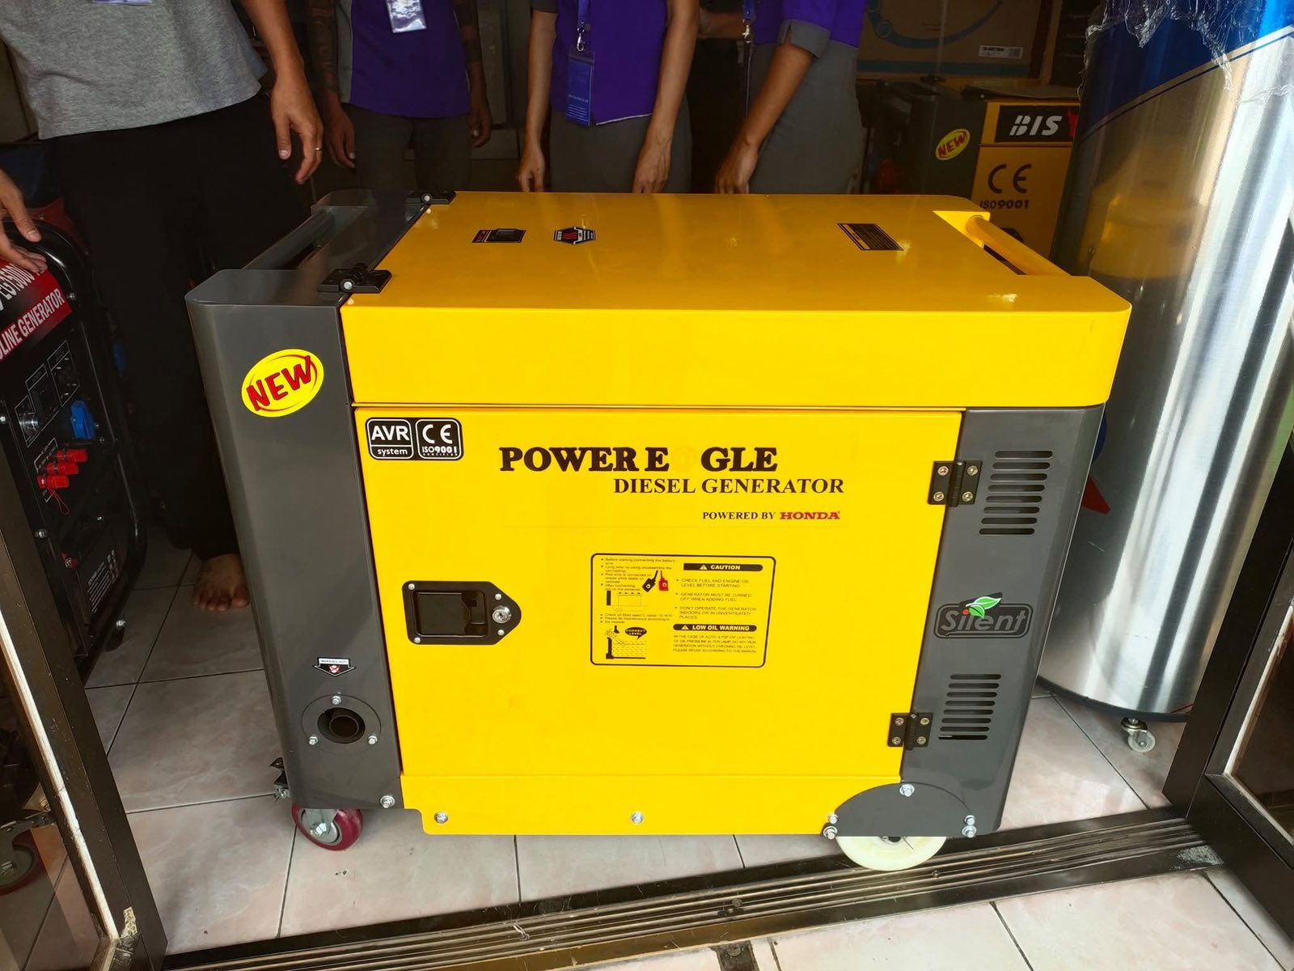
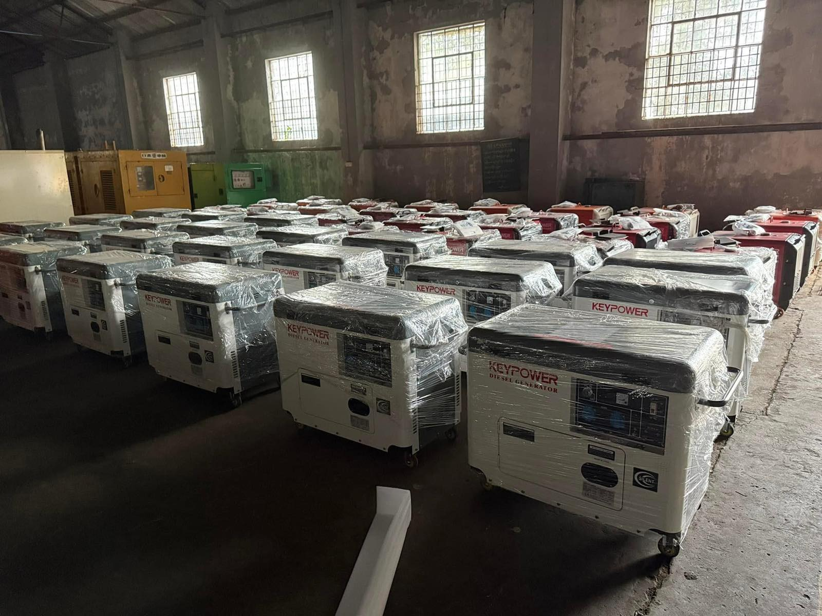
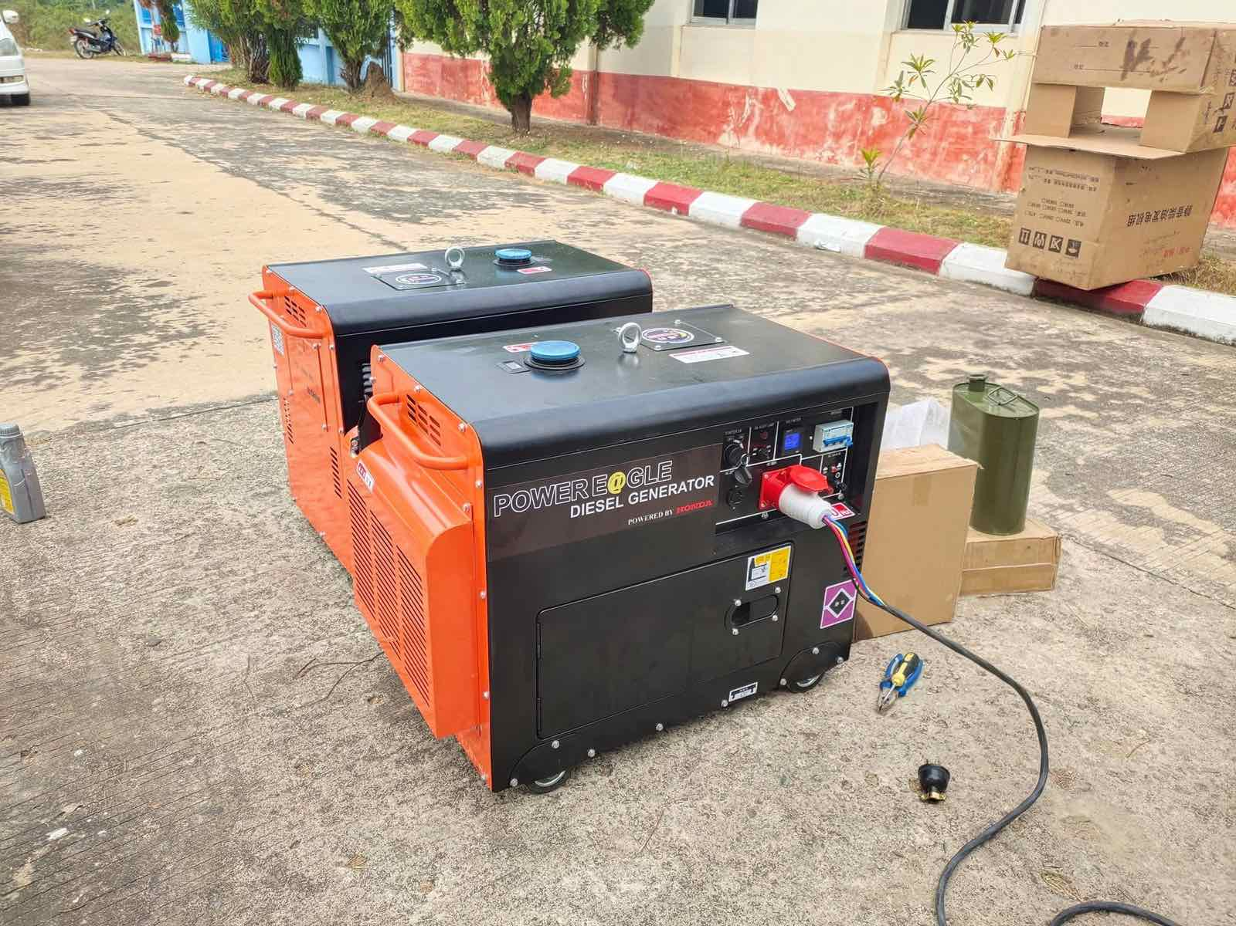
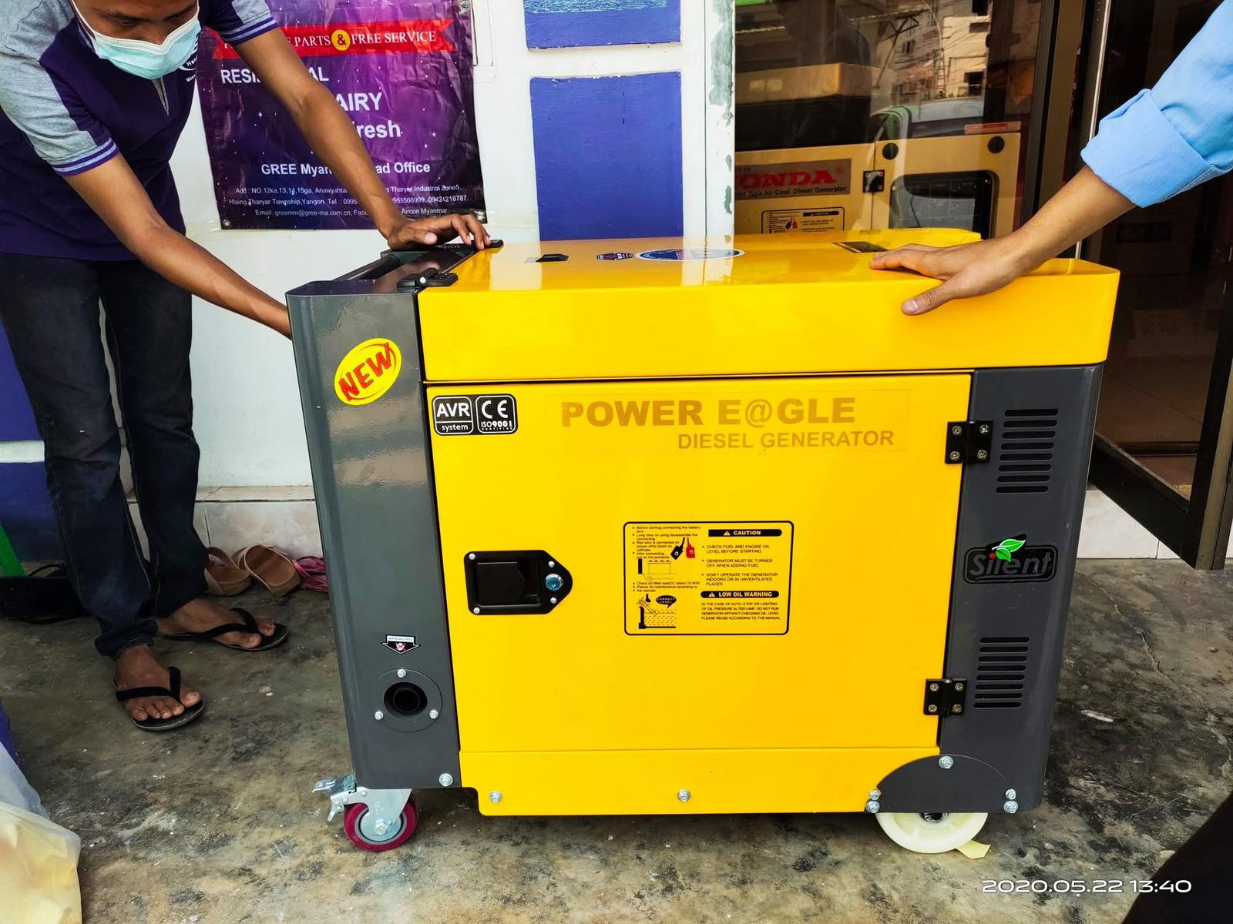
COMPANY SERVICES
Generators ( 5kVA to 1000 kVA)

Slide 12
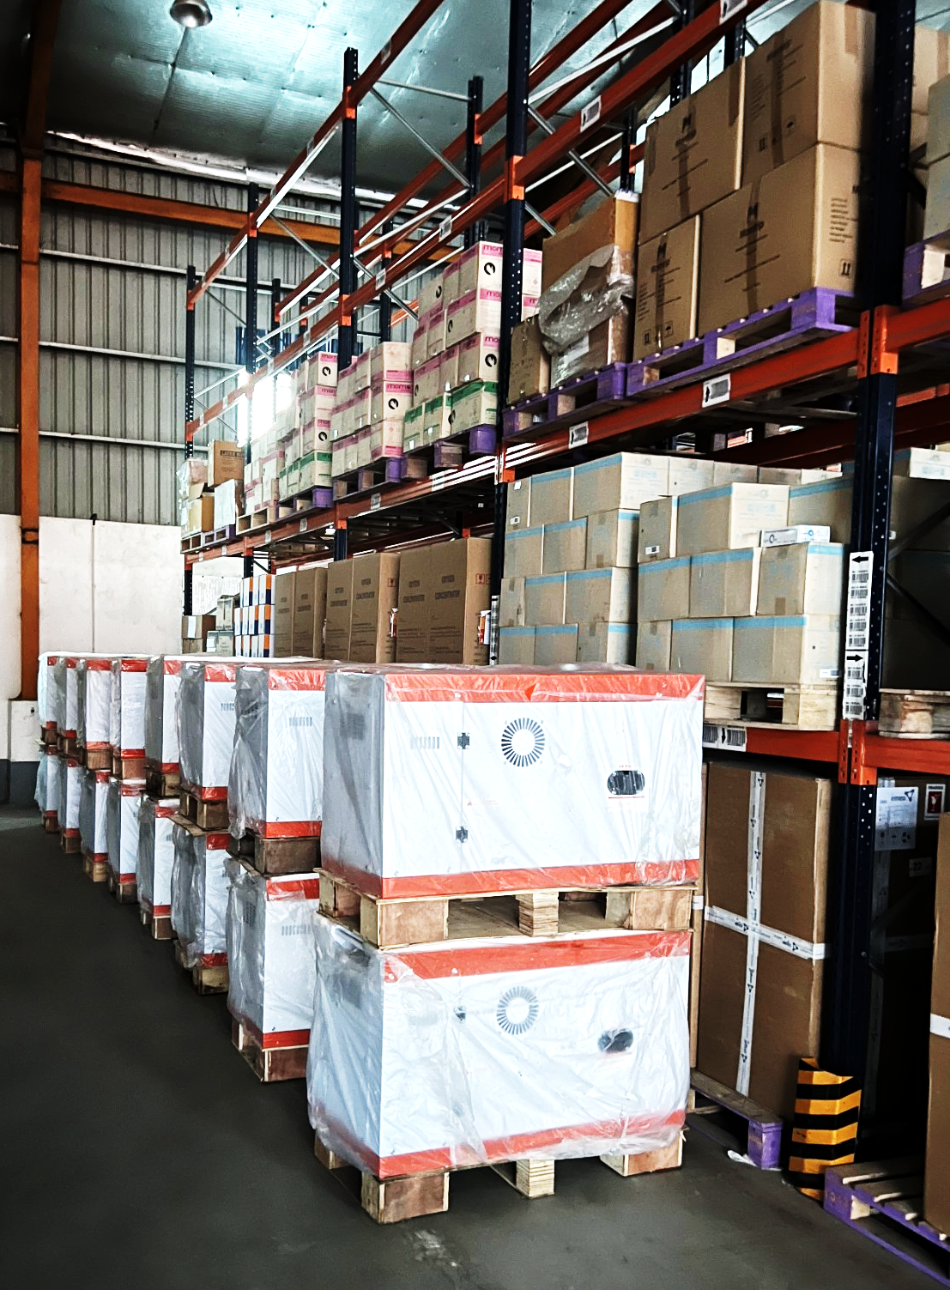
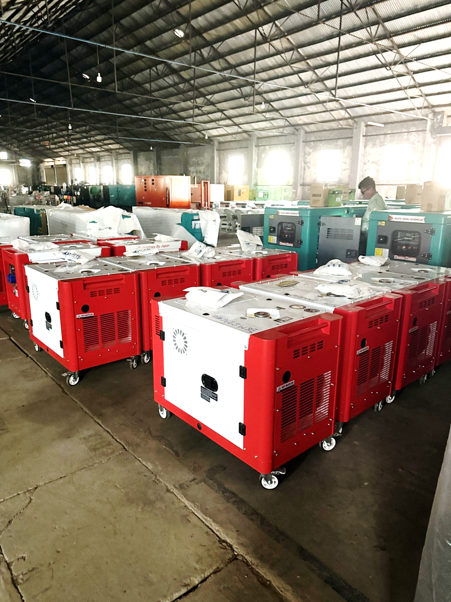
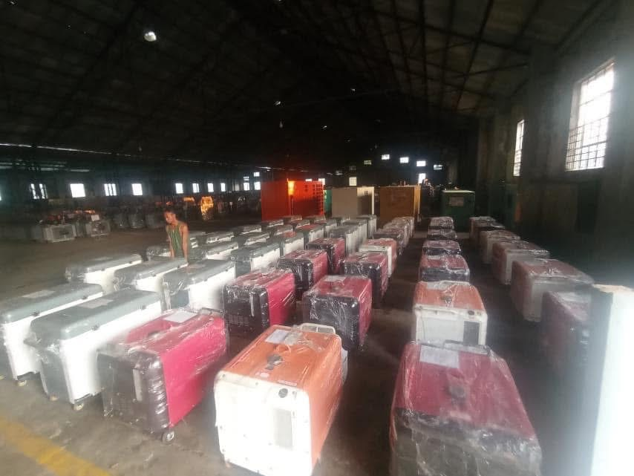
COMPANY SERVICES
Generators ( 5kVA to 1000 kVA)

Slide 13
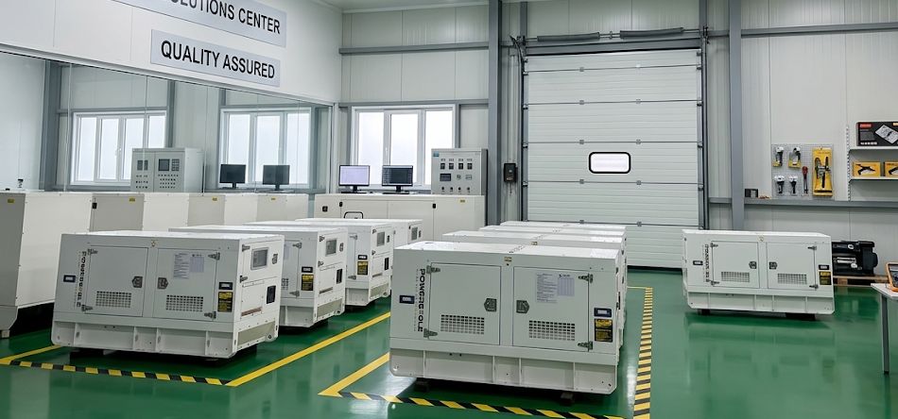
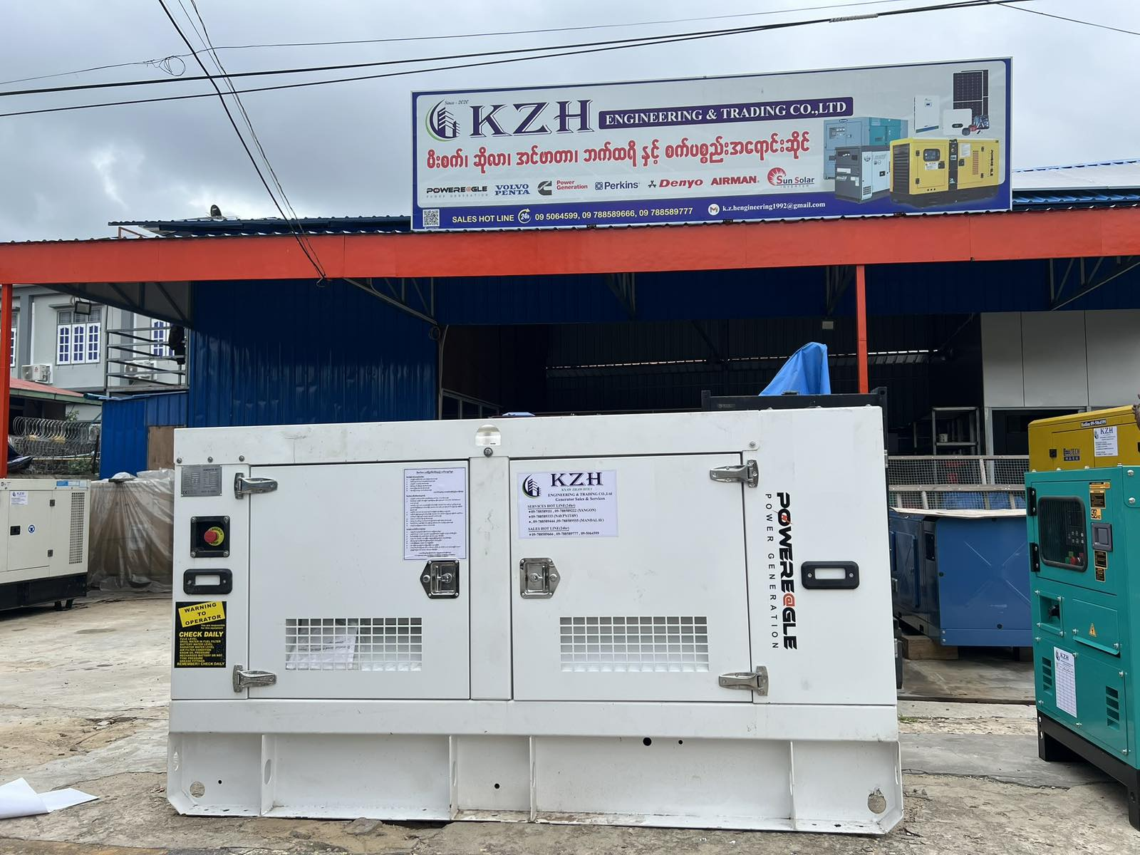
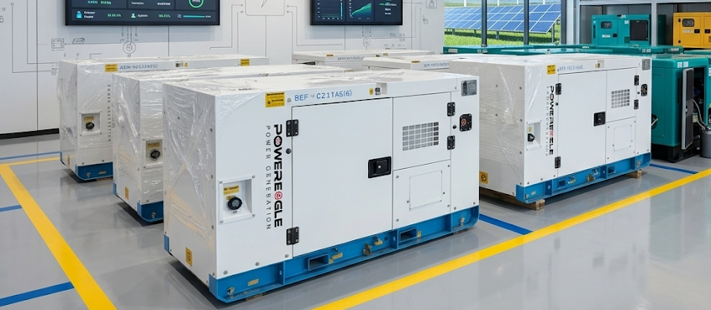
COMPANY SERVICES
Generators ( 5kVA to 3250 kVA)

Slide 14
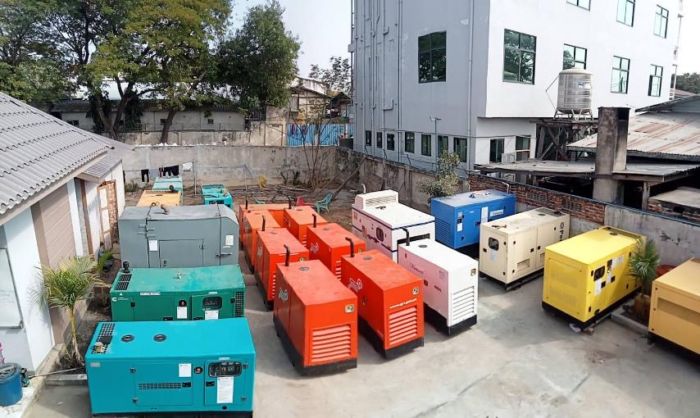
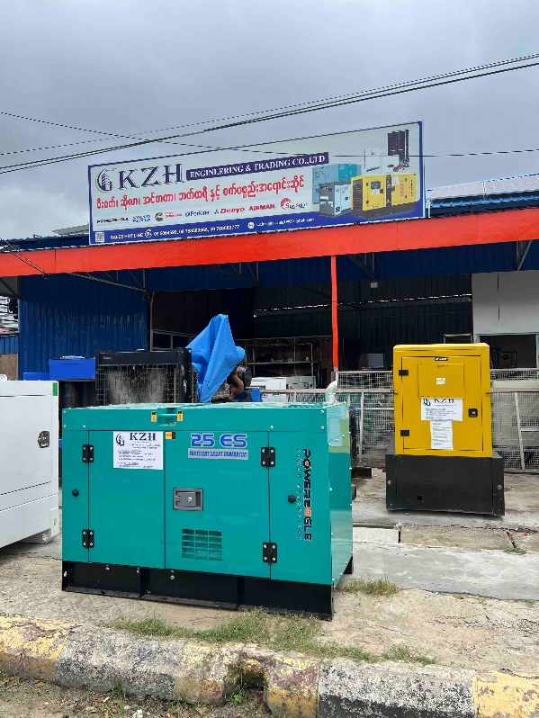
COMPANY SERVICES
Generators ( 5kVA to 3250 kVA)

Slide 15
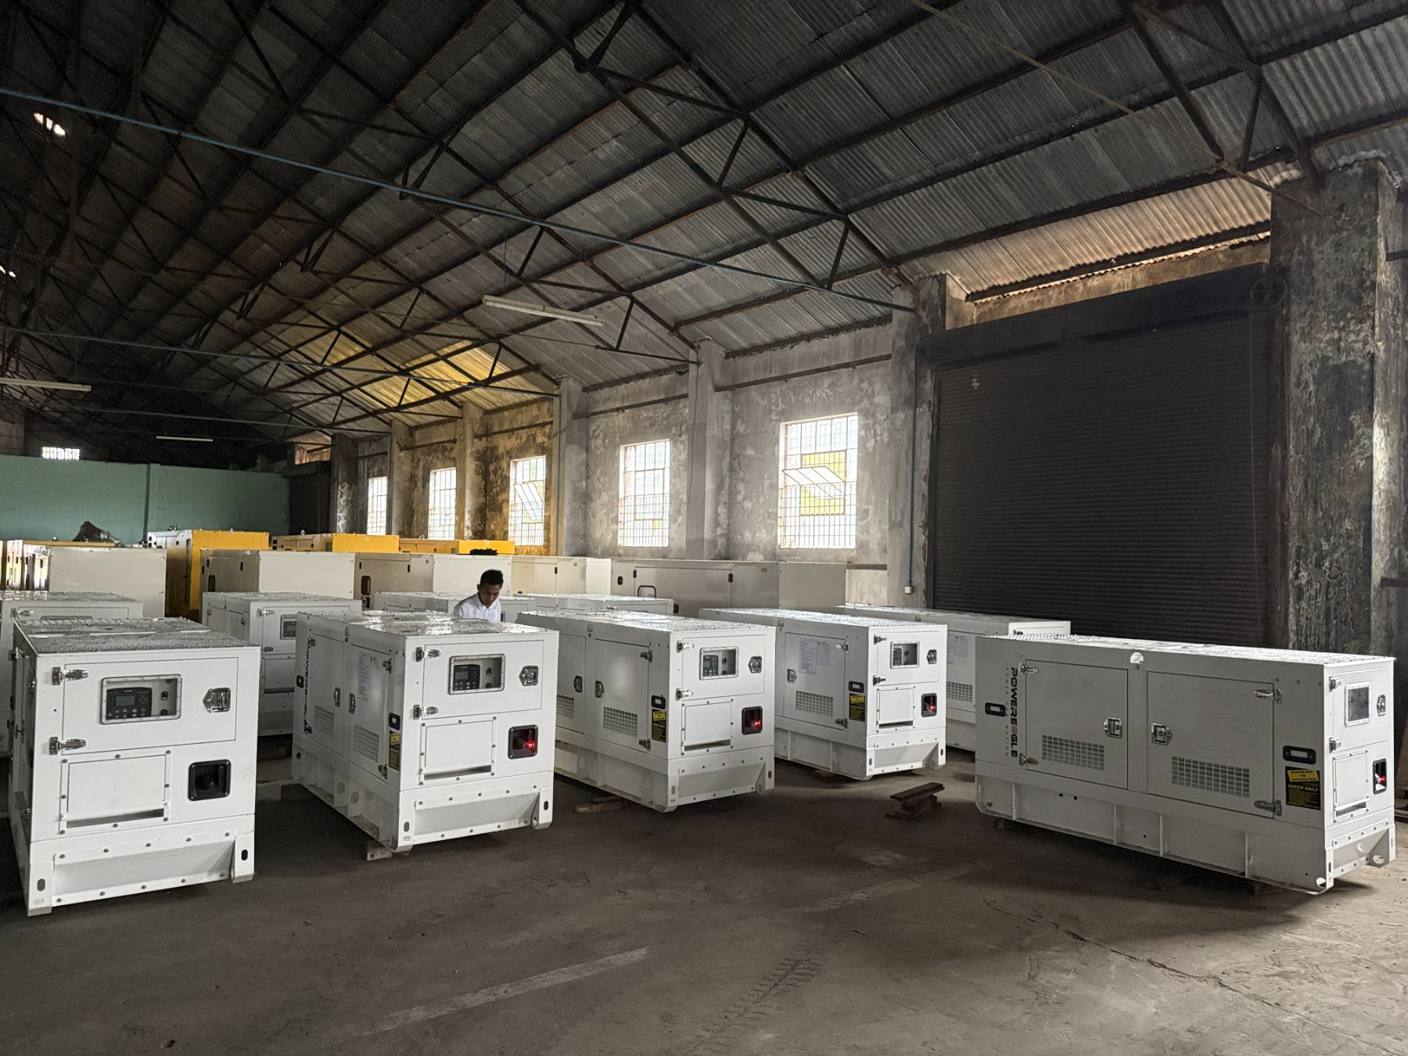
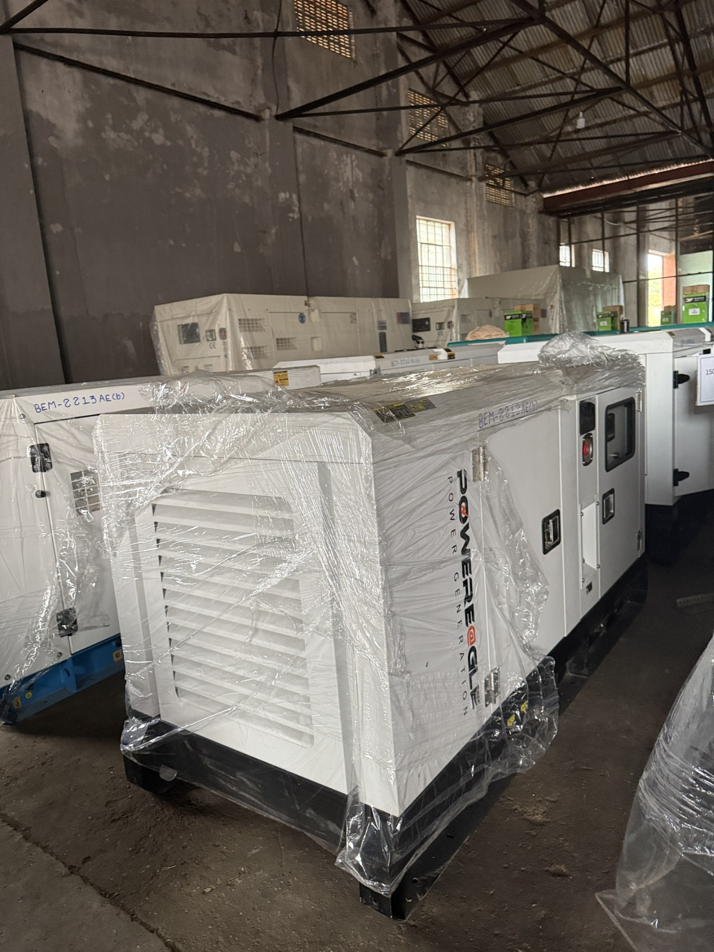
COMPANY SERVICES
Generators ( 5kVA to 3250 kVA)

Slide 16
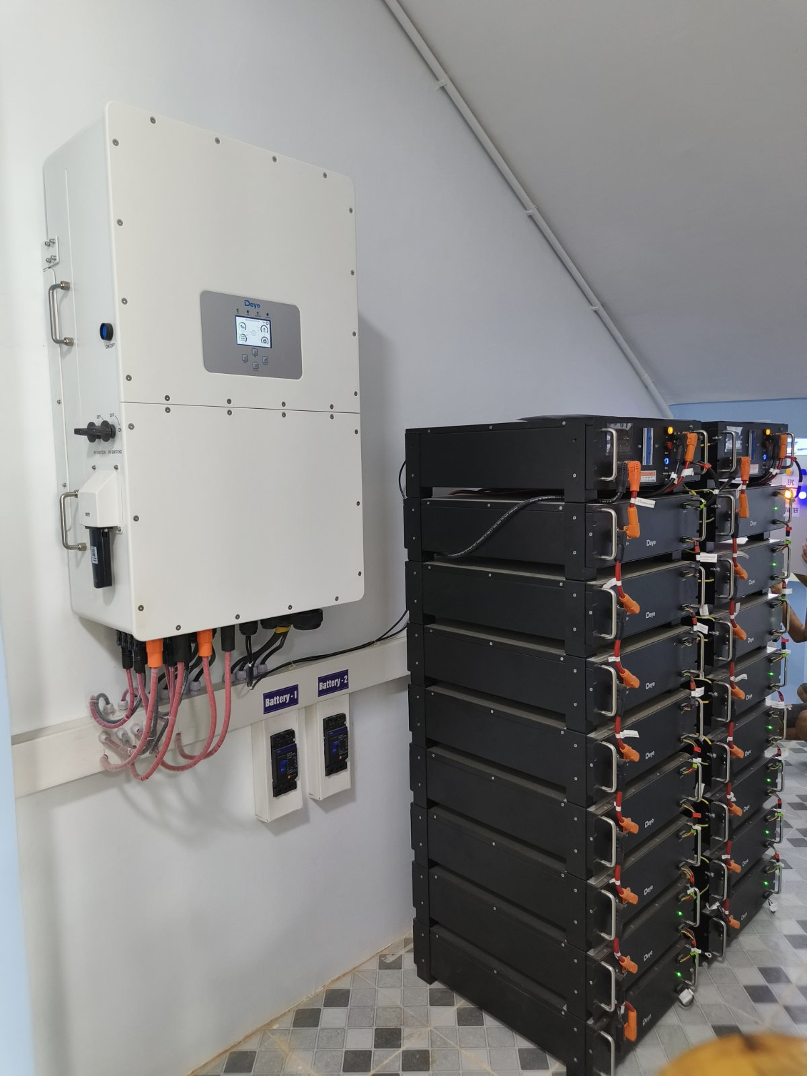
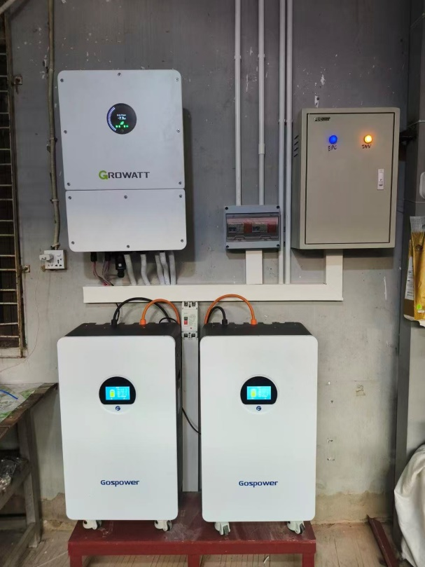
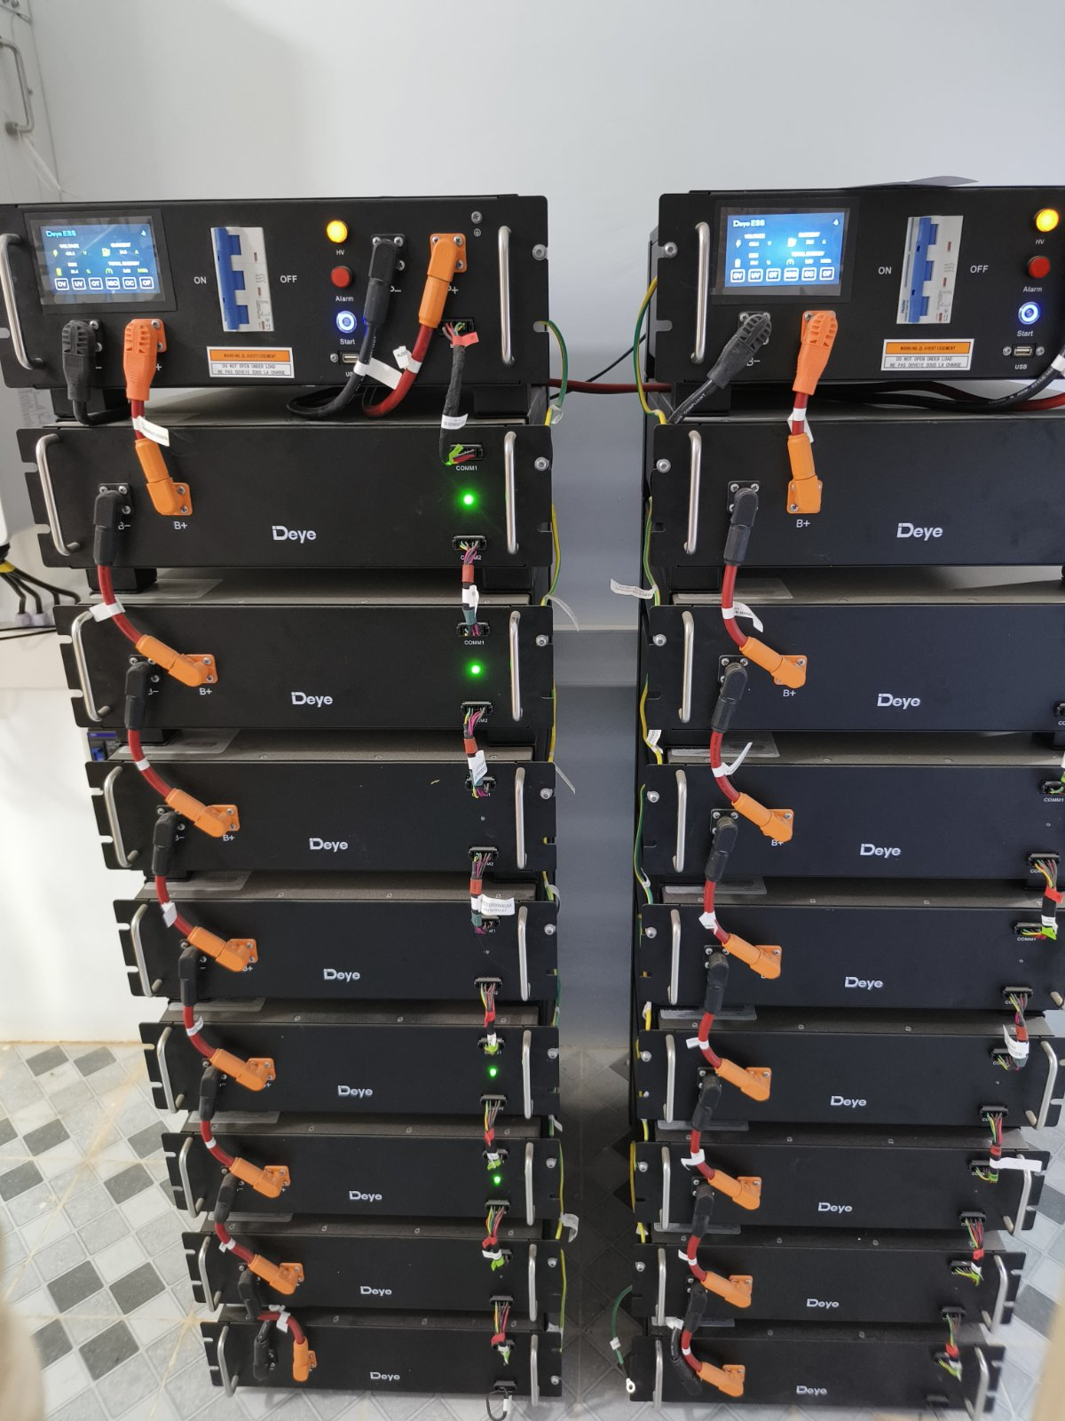
COMPANY SERVICES
Solar 30K High Voltage

Slide 17
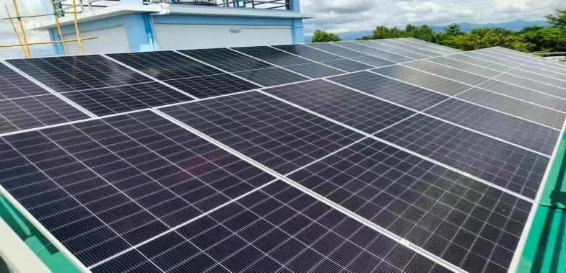
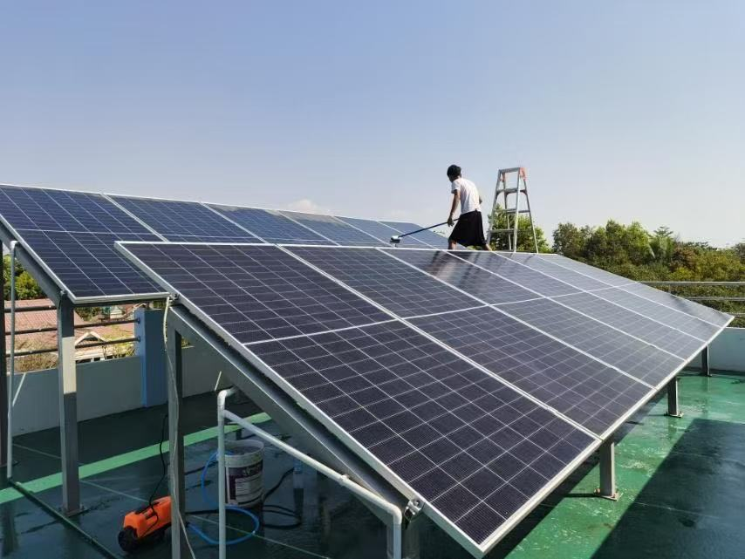

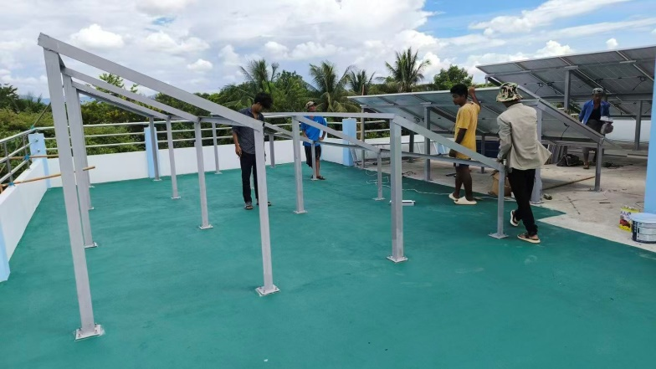
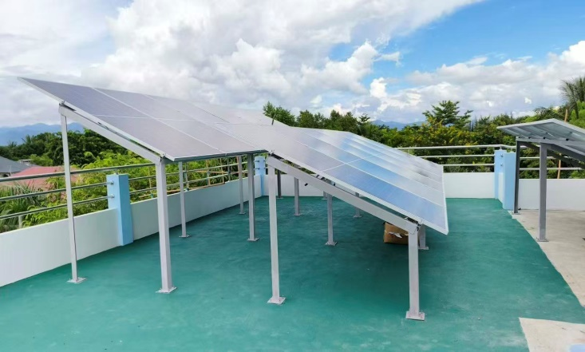
COMPANY SERVICES
Solar 15K Low Voltage

Slide 18
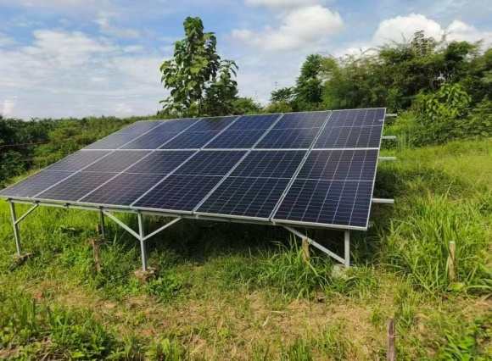
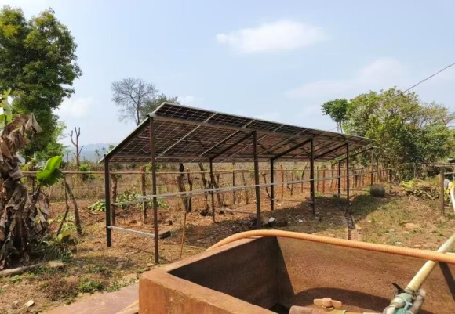
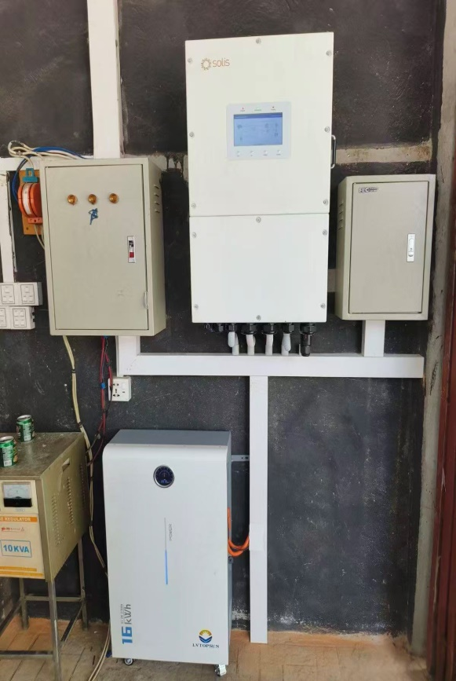
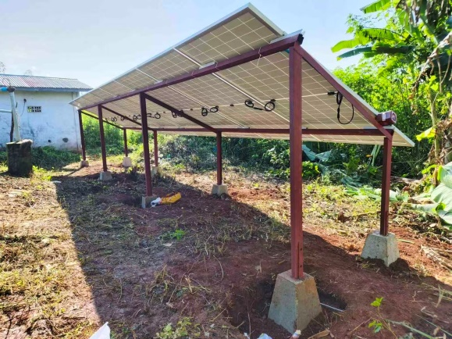
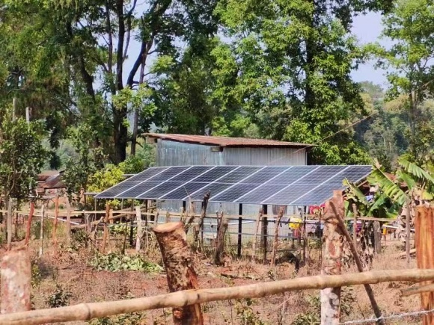
COMPANY SERVICES
Solar 585W 12K Low Voltage

Slide 19
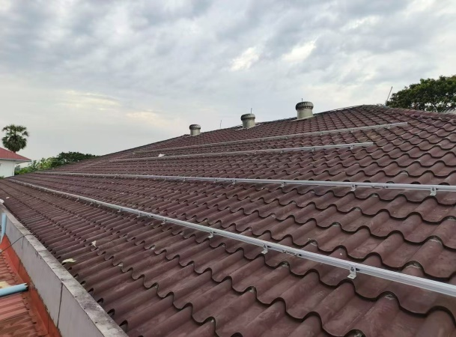
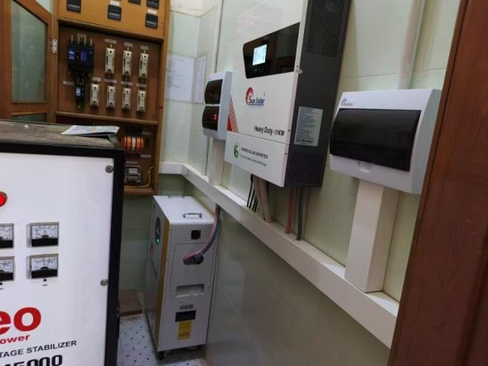
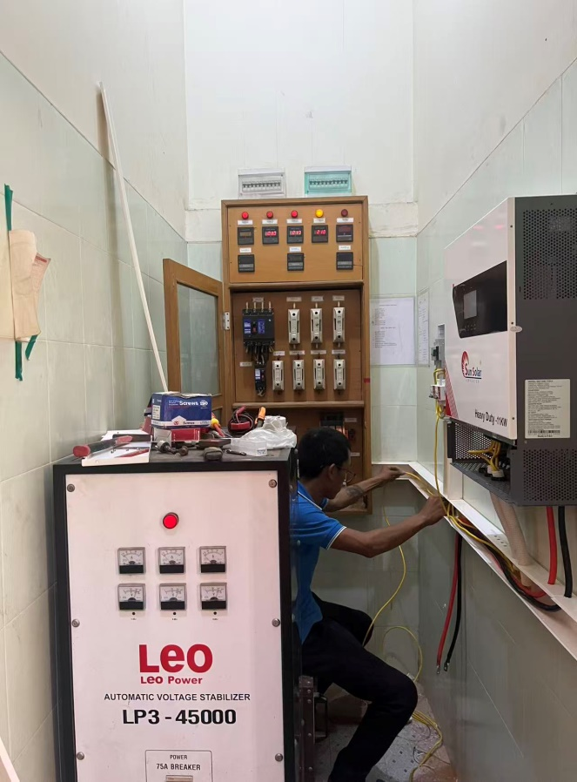
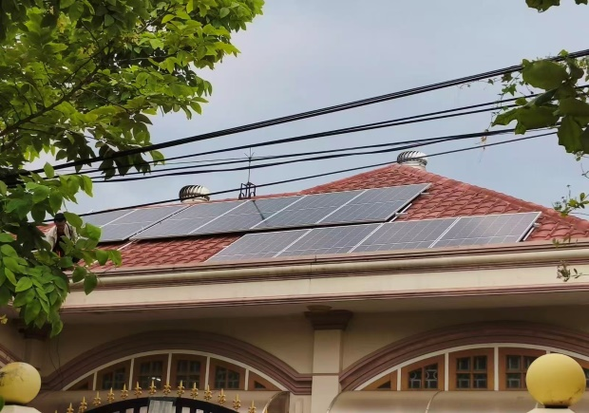
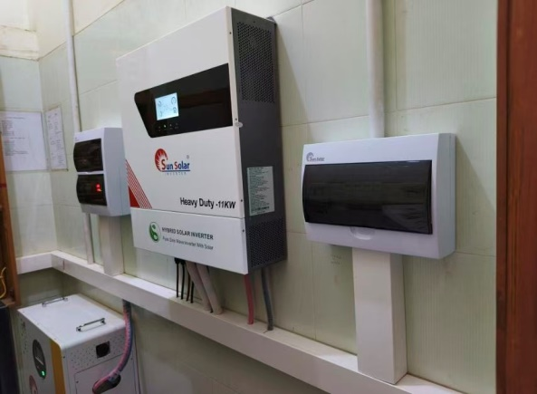
COMPANY SERVICES
Solar 11K Low Voltage

Slide 20
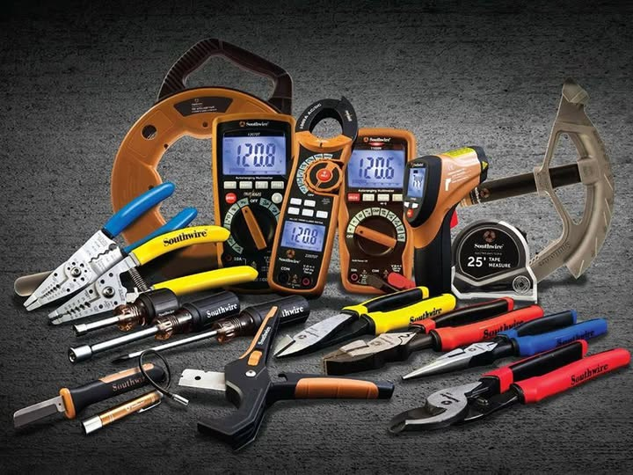
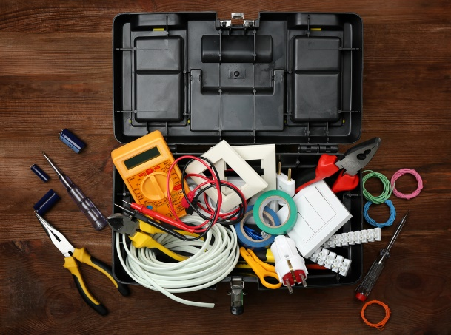
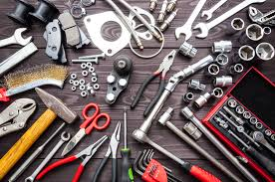
COMPANY SERVICES
Engineering Teaching Aids & Electrical & Mechanical Hand Tools

Slide 21
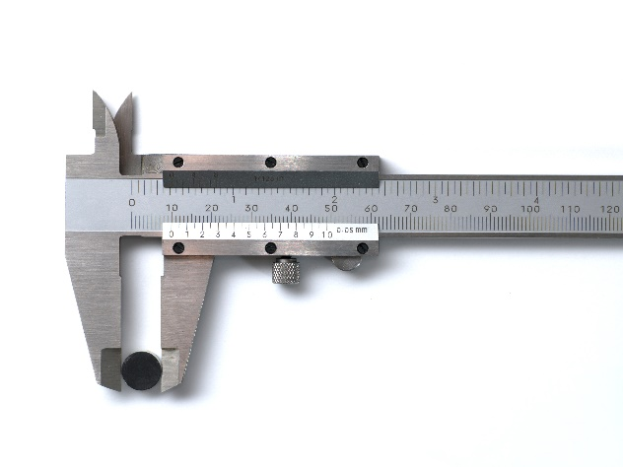
COMPANY SERVICES
Engineering Teaching Aids & Electrical & Mechanical Hand Tools

Slide 22
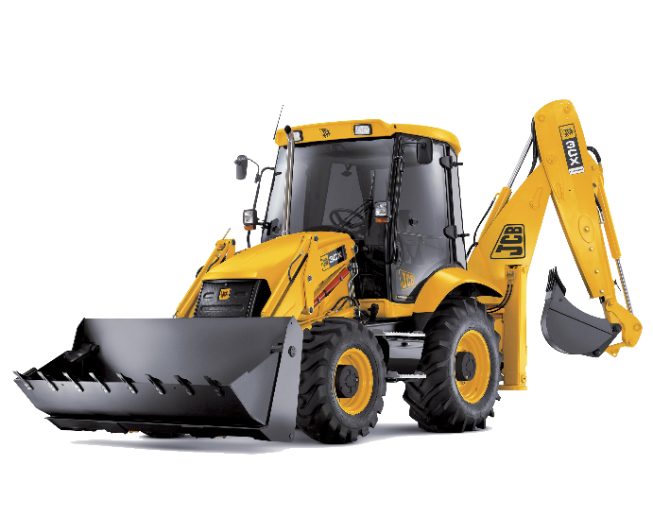
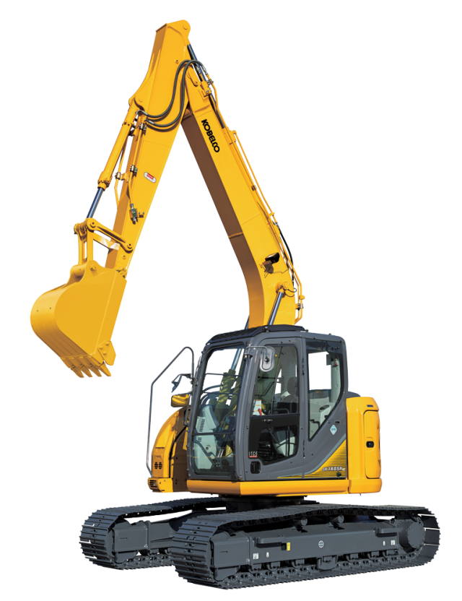
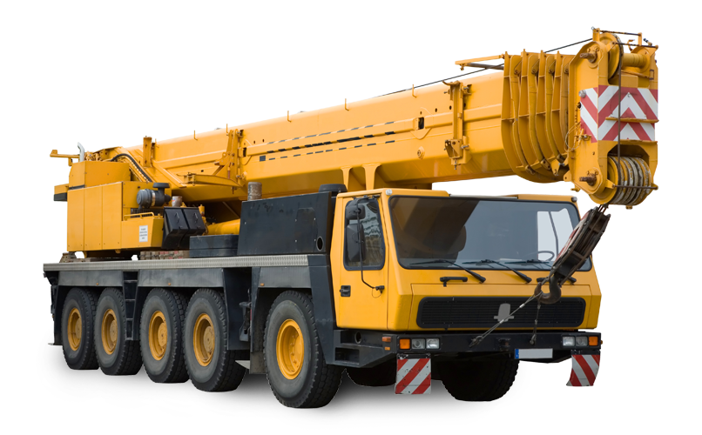
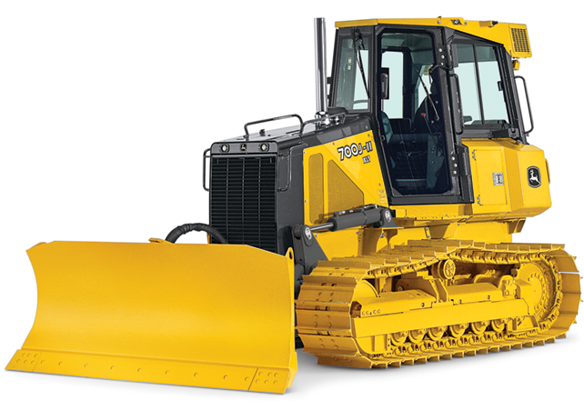
COMPANY SERVICES
Engineering Teaching Aids & Electrical & Mechanical Hand Tools

Slide 23
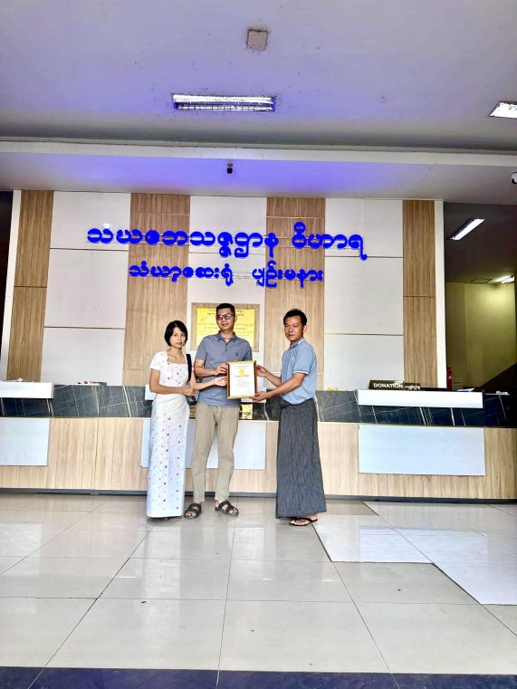
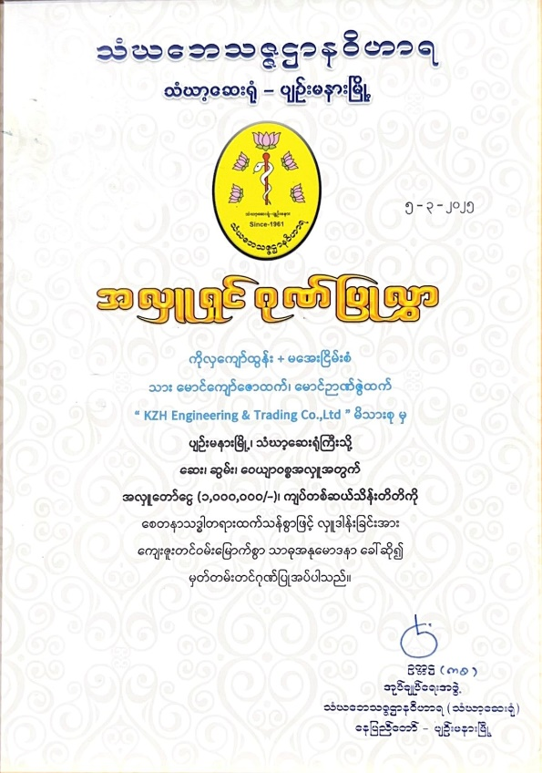
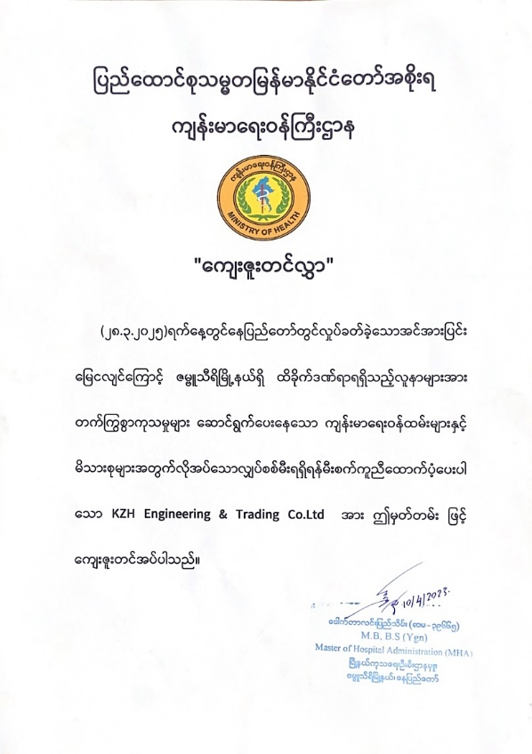
COMPANY ACTIVITIES

Slide 24
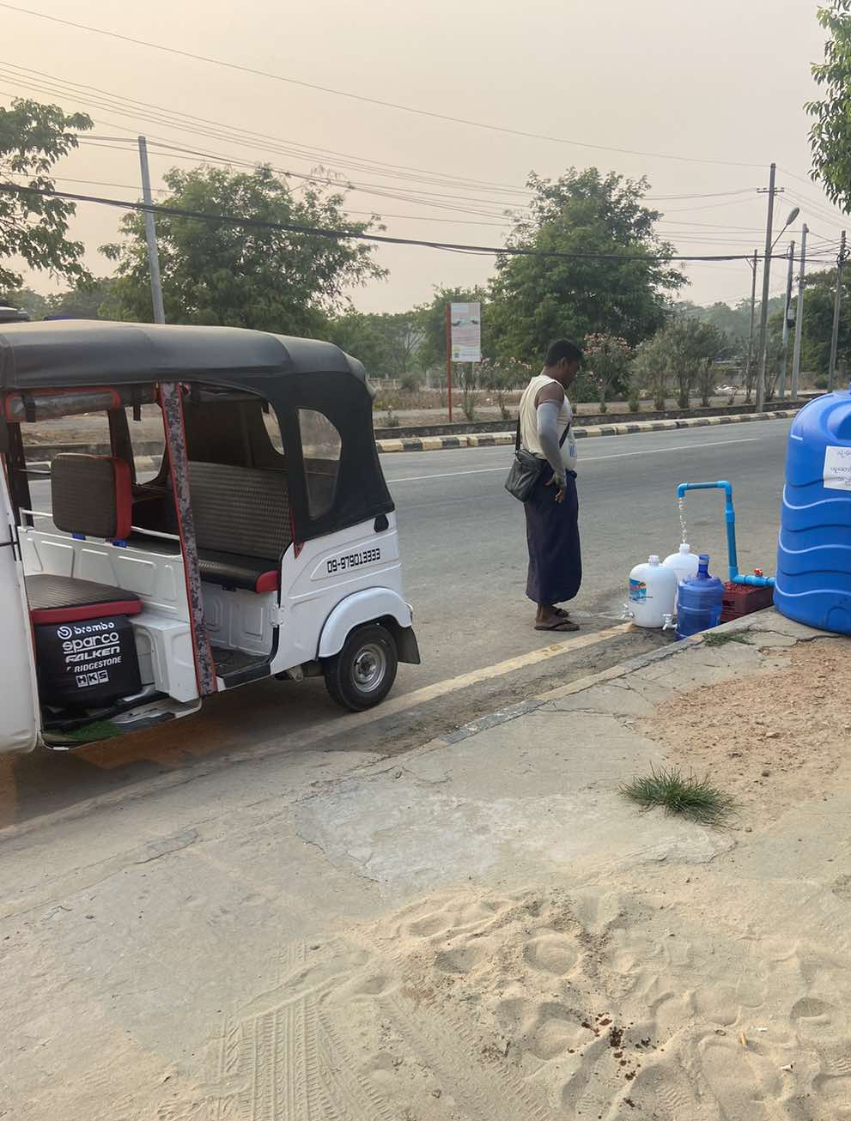
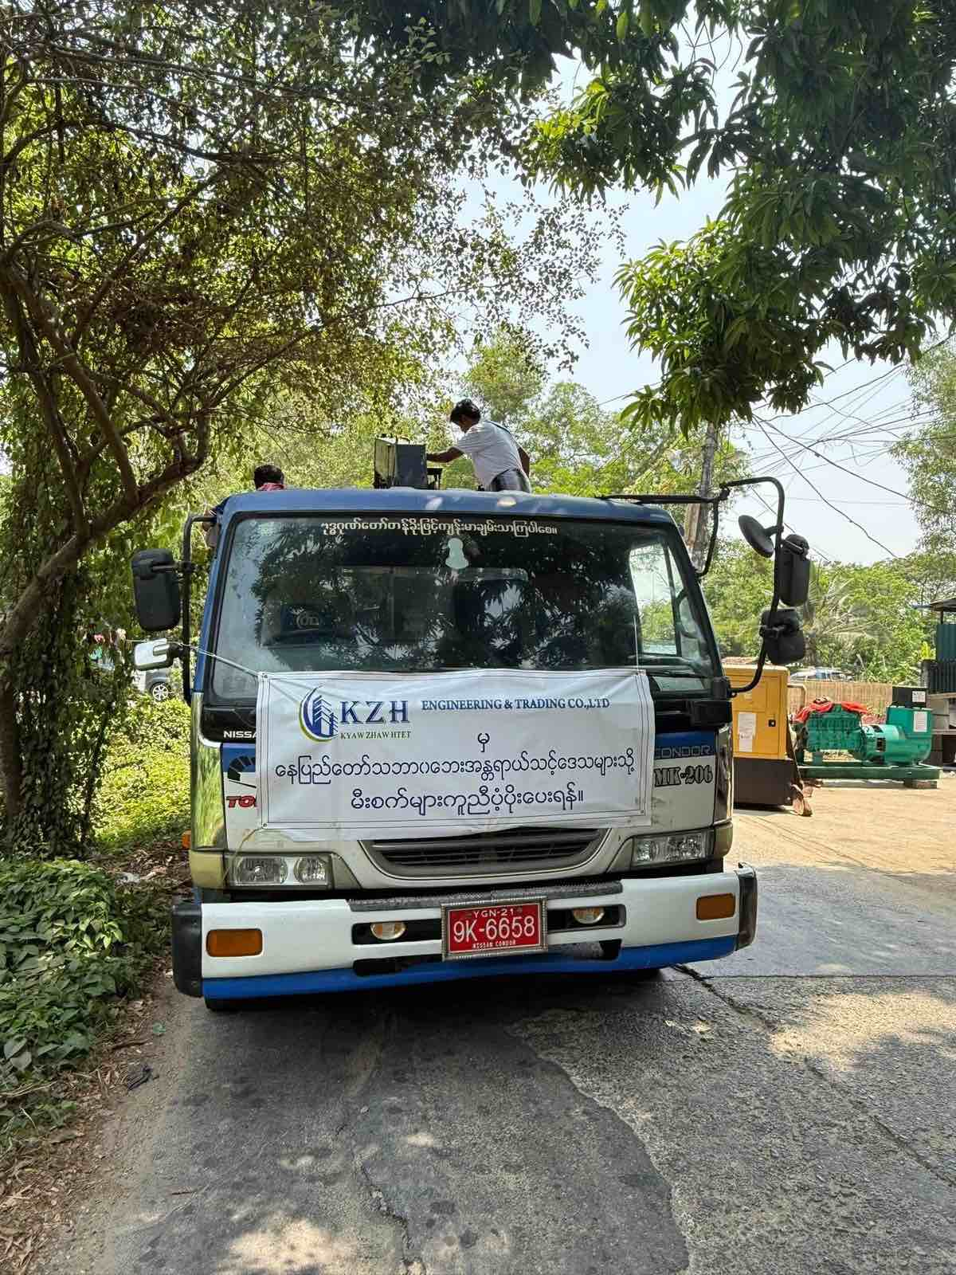
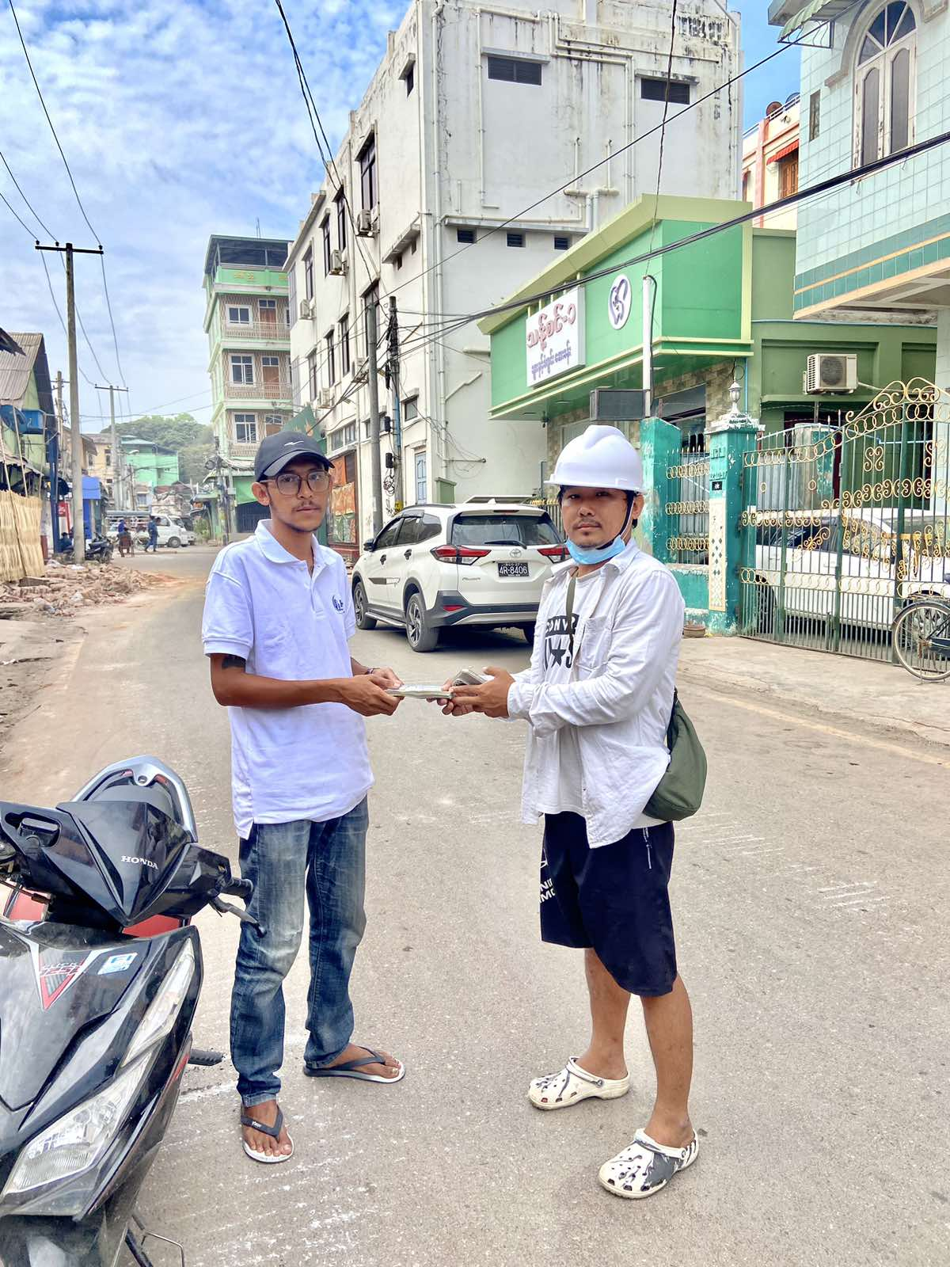
COMPANY ACTIVITIES

Slide 25
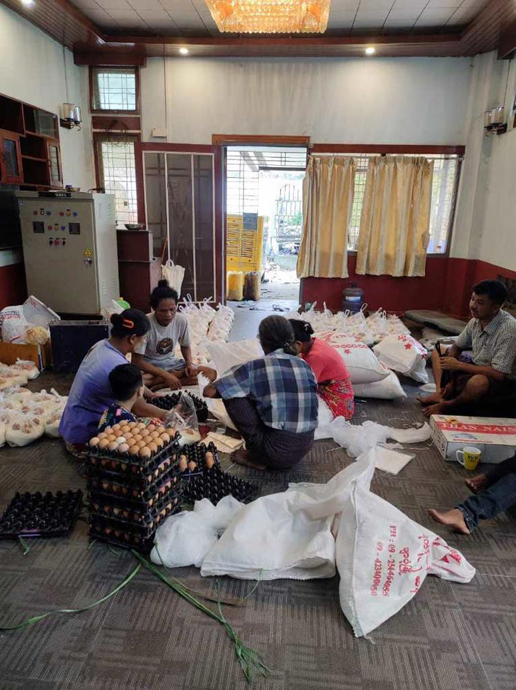
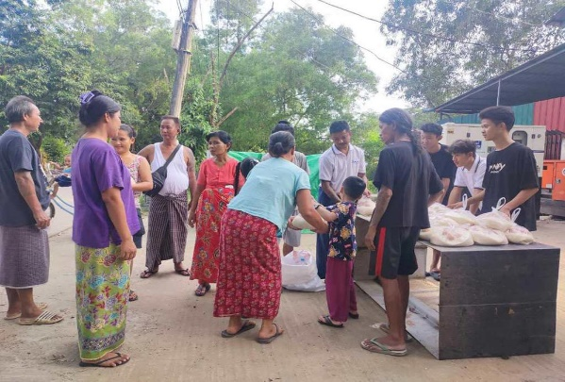


COMPANY ACTIVITIES

Slide 26



COMPANY ACTIVITIES

Slide 27
CONTACT US
Nay Pyi Taw - No-7/70 ,Pannkin Main St,Pannkin (2) Qtr, Pyinmana Tsp,Naypyitaw, Myanmar
Yangon - No-190-191, VIP Ward, Pyi Daung Su St, Shwe Pyi Thar, Yangon.
Mandalay - Between 116-117 St, 64 St, Pyi Gyi Tagon Tsp, Mandalay, Myanmar.
Sales Hot Line - 09-422250334, 09-422250335, 09-422250336
Services Hot Line - 09-788589111, 09-788589222, 09-788589333, 09-788589444,
09-788589555,09-788589666, 09-78858977
E-mail : k.z.hengineering1992@gmail.com
https://www,kzhengineeringgroup.com

